Slide 1
Linear Algebra

Slide 2
Row Echelon Form
Previously we learned a method for reducing an n × n linear system to strict triangular
form. However, this method will fail if, at any stage of the reduction process, all the possible choices for a pivot element in a given column are 0.

Slide 3
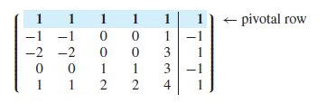
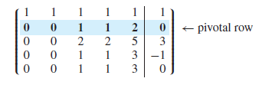
Consider the system represented by the augmented matrix
If row operations are used to eliminate the nonzero entries in the last four rows of the
first column, the resulting matrix will be

Slide 4
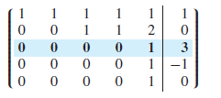
At this stage, the reduction to strict triangular form breaks down. All four possible
choices for the pivot element in the second column are 0. How do we proceed from here? Since our goal is to simplify the system as much as possible, it seems natural to
move over to the third column and eliminate the last three entries:

Slide 5
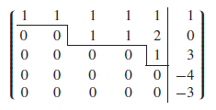
In the fourth column, all the choices for a pivot element are 0; so again we move on to the next column. If we use the third row as the pivotal row, the last two entries in the fifth column are eliminated and we end up with the matrix
The coefficient matrix that we end up with is not in strict triangular form; it is in echelon form.

Slide 6

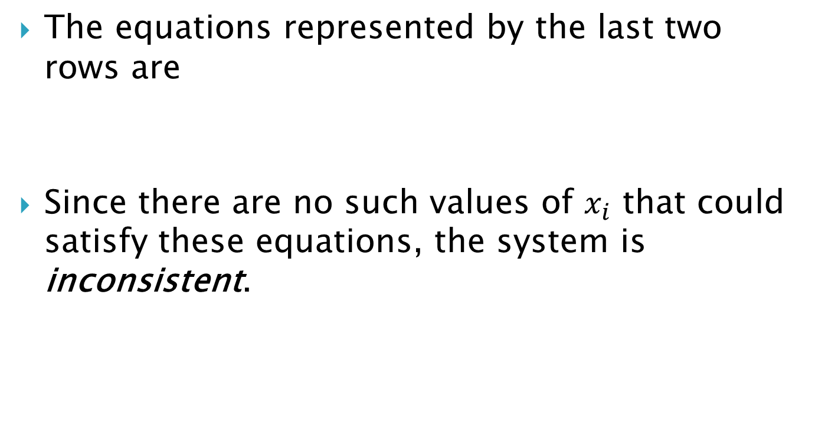
The equations represented by the last two rows are
Since there are no such values of $x_{i}$ that could satisfy these equations, the system is inconsistent.

Slide 7
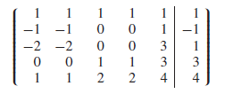
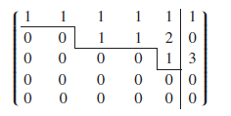
Suppose now that we change the right-hand side of the system so as to obtain a consistent system. For example, if we start with
then the reduction process will yield the echelon-form augmented matrix

Slide 8


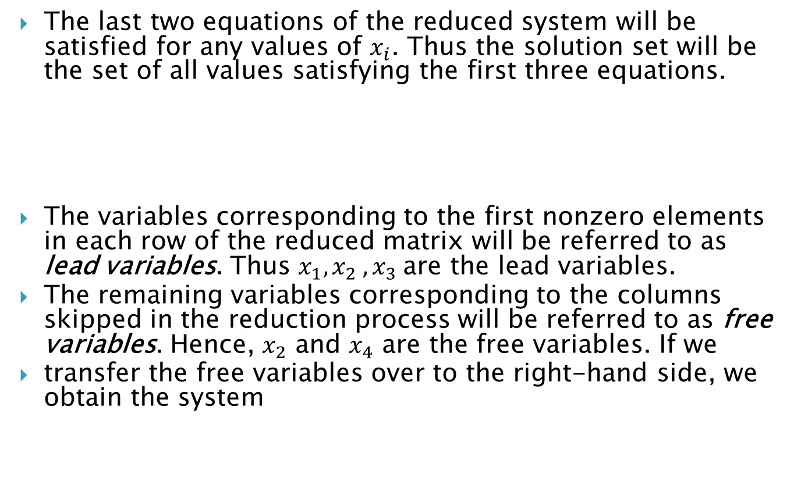
The last two equations of the reduced system will be satisfied for any values of $x_{i}$. Thus the solution set will be the set of all values satisfying the first three equations.
The variables corresponding to the first nonzero elements in each row of the reduced matrix will be referred to as lead variables. Thus $x_{1}, x_{2} , x_{3}$are the lead variables.
The remaining variables corresponding to the columns skipped in the reduction process will be referred to as free variables. Hence, $x_{2}$ and $x_{4}$ are the free variables. If we
transfer the free variables over to the right-hand side, we obtain the system

Slide 9

The last system is strictly triangular in the unknowns $x_{1}, x_{3}$ and $x_{5}$.Thus , for each pair of values $x_{2}$ and $x_{4}$, there will be a unique solution. In general, this system has infinitely many solutions.

Slide 10
A matrix is said to be in row echelon form if :
1. Any all-zero rows are below all other rows;
2. The first non-zero entry of any row (called the pivot entry) is strictly further right
than the first non-zero entry of any row above it.

Slide 11
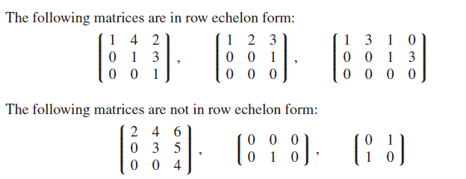

Slide 12
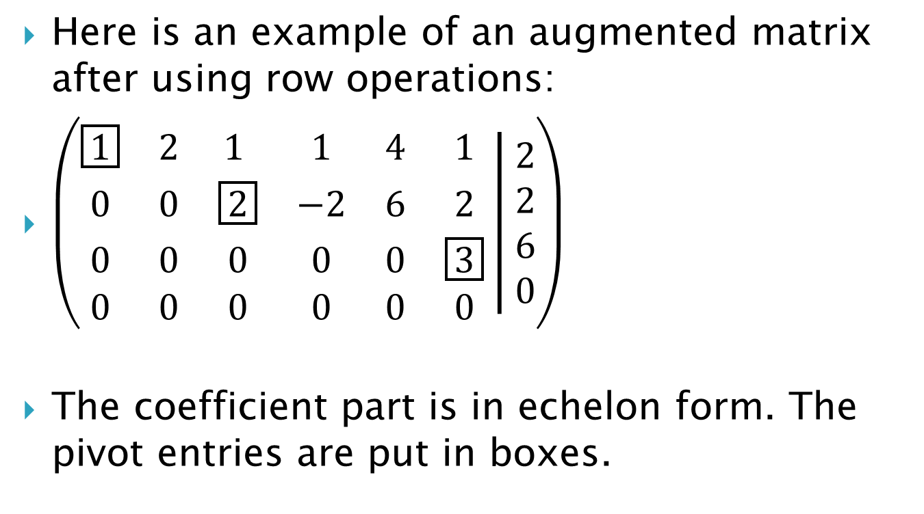
Here is an example of an augmented matrix after using row operations:
$\left(\begin{matrix}\boxed{1} & 2 & 1 & 1 & 4 & 1 \\ 0 & 0 & \boxed{2} & −2 & 6 & 2 \\ 0 & 0 & 0 & 0 & 0 & \boxed{3} \\ 0 & 0 & 0 & 0 & 0 & 0\end{matrix} | \begin{matrix}2 \\ 2 \\ 6 \\ 0\end{matrix}\right)$
The coefficient part is in echelon form. The pivot entries are put in boxes.

Slide 13

If the row echelon form of the augmented matrix contains a row of the form
the system is inconsistent. Otherwise, the system will be consistent. If the system is
consistent and the nonzero rows of the row echelon form of the matrix form a strictly
triangular system, the system will have a unique solution.

Slide 14
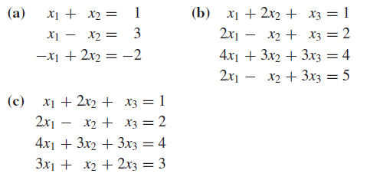
Overdetermined Systems
A linear system is said to be overdetermined if there are more equations than unknowns. Overdetermined systems are usually (but not always) inconsistent.
Example 1. Solve each of the following overdetermined systems:

Slide 15
Underdetermined Systems
A system of m linear equations in n unknowns is said to be underdetermined if there are fewer equations than unknowns (m < n). Although it is possible for underdetermined systems to be inconsistent, they are usually consistent with infinitely many solutions. It is not possible for an underdetermined system to have a unique solution. Therefore, a consistent underdetermined system will have infinitely many solutions.

Slide 16
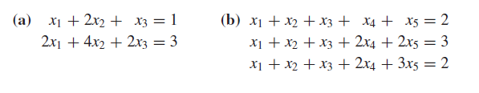
Example 2. Solve the following underdetermined systems:
In the case where the row echelon form of a consistent system has free variables, the standard procedure is to continue the elimination process until all the entries above each leading 1 have been eliminated. The resulting reduced matrix is said to be in reduced row echelon form.

Slide 17
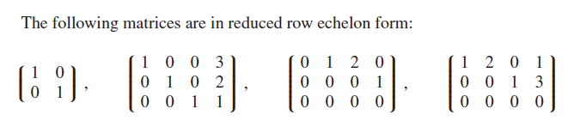
A matrix is said to be in reduced row echelon form if all the following are true
1. It is in echelon form.
2. The first non-zero entry of any row is 1. This is called a pivotal 1.
3. All entries above a pivotal 1 are 0.

Slide 18
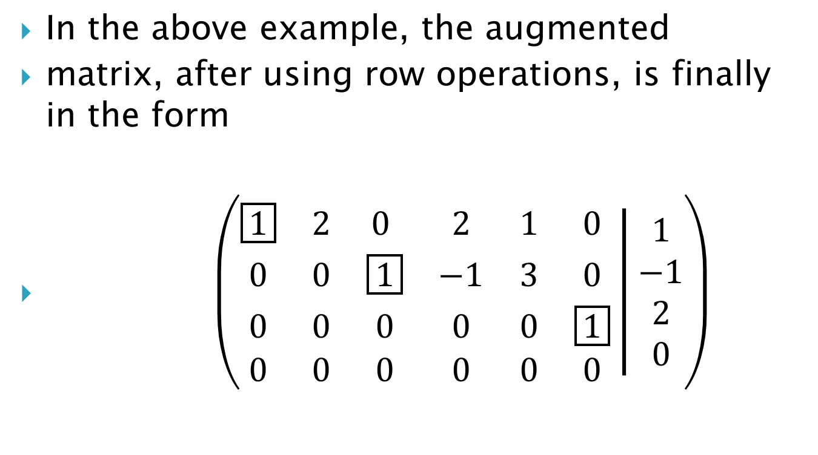
In the above example, the augmented
matrix, after using row operations, is finally in the form
$\left(\begin{matrix}\boxed{1} & 2 & 0 & 2 & 1 & 0 \\ 0 & 0 & \boxed{1} & −1 & 3 & 0 \\ 0 & 0 & 0 & 0 & 0 & \boxed{1} \\ 0 & 0 & 0 & 0 & 0 & 0\end{matrix} | \begin{matrix}1 \\ −1 \\ 2 \\ 0\end{matrix}\right)$

Slide 19
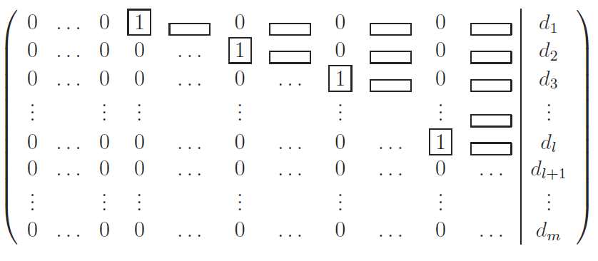

Consider now a general system of m equations for $n$ unknowns. The coefficient matrix A has dimensions $m×n$. At the end of Gaussian elimination it has the form

Slide 20
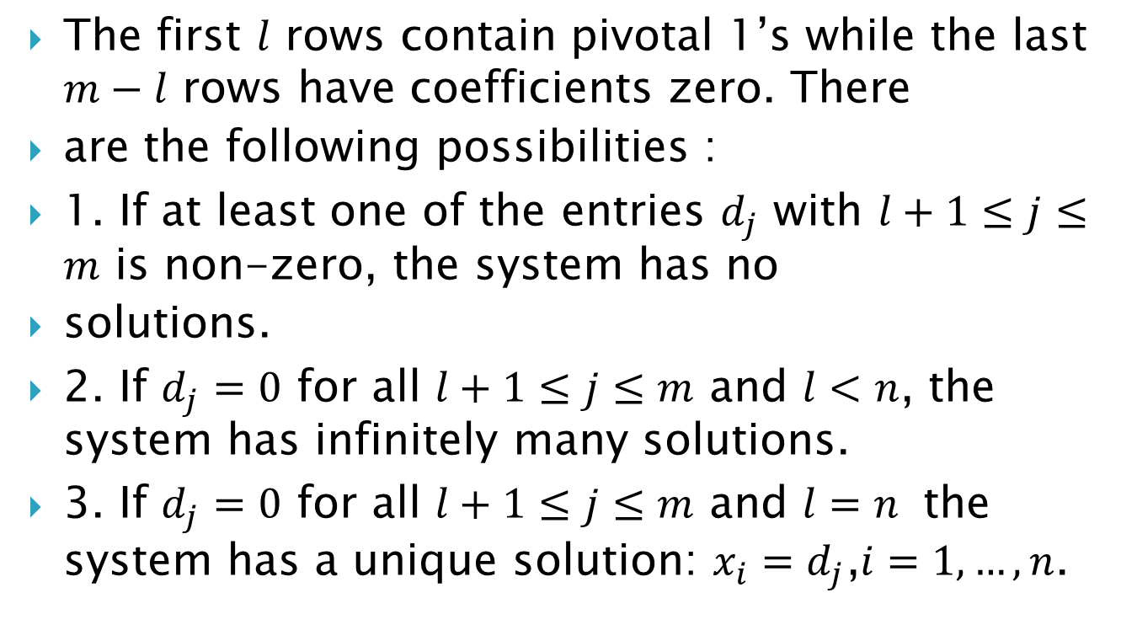
The first $l$ rows contain pivotal 1’s while the last $m−l$ rows have coefficients zero. There
are the following possibilities :
1. If at least one of the entries $d_{j}$ with $l+1≤j≤m$ is non-zero, the system has no
solutions.
2. If $d_{j}=0$ for all $l+1≤j≤m$ and $l<n$, the system has infinitely many solutions.
3. If $d_{j}=0$ for all $l+1≤j≤m$ and $l=n$ the system has a unique solution: $x_{i}=d_{j}$,$i=1,…, n$.

Slide 21
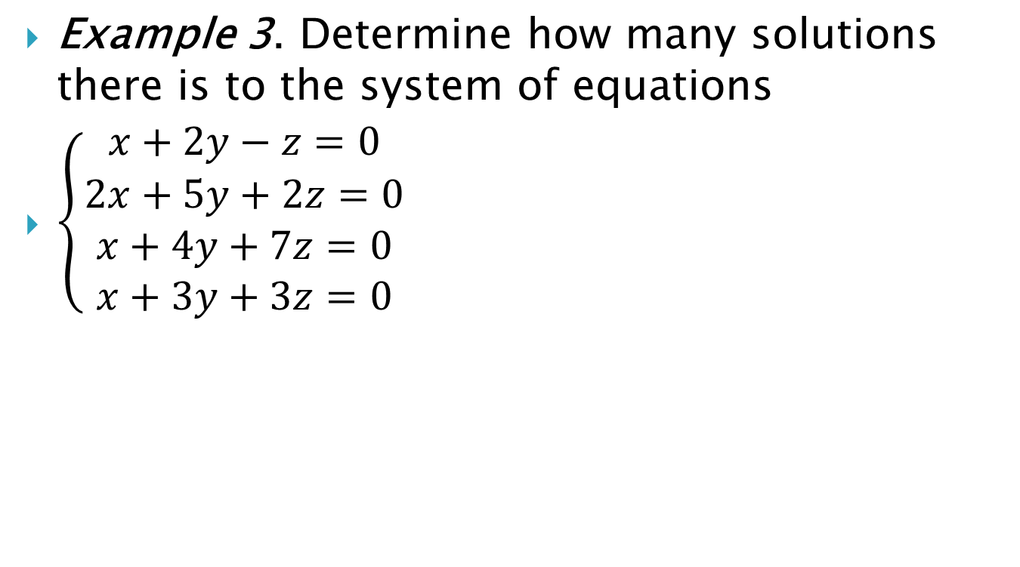
Example 3. Determine how many solutions there is to the system of equations
$\left\{\begin{aligned}x+2y−z=0 \\ 2x+5y+2z=0 \\ x+4y+7z=0 \\ x+3y+3z=0\end{aligned}\right.$

Slide 22

Example 4. Solve the system
$\left\{\begin{aligned}x+3y−5z+w=4 \\ 2x+5y−2z+4w=6\end{aligned}\right.$

Slide 23
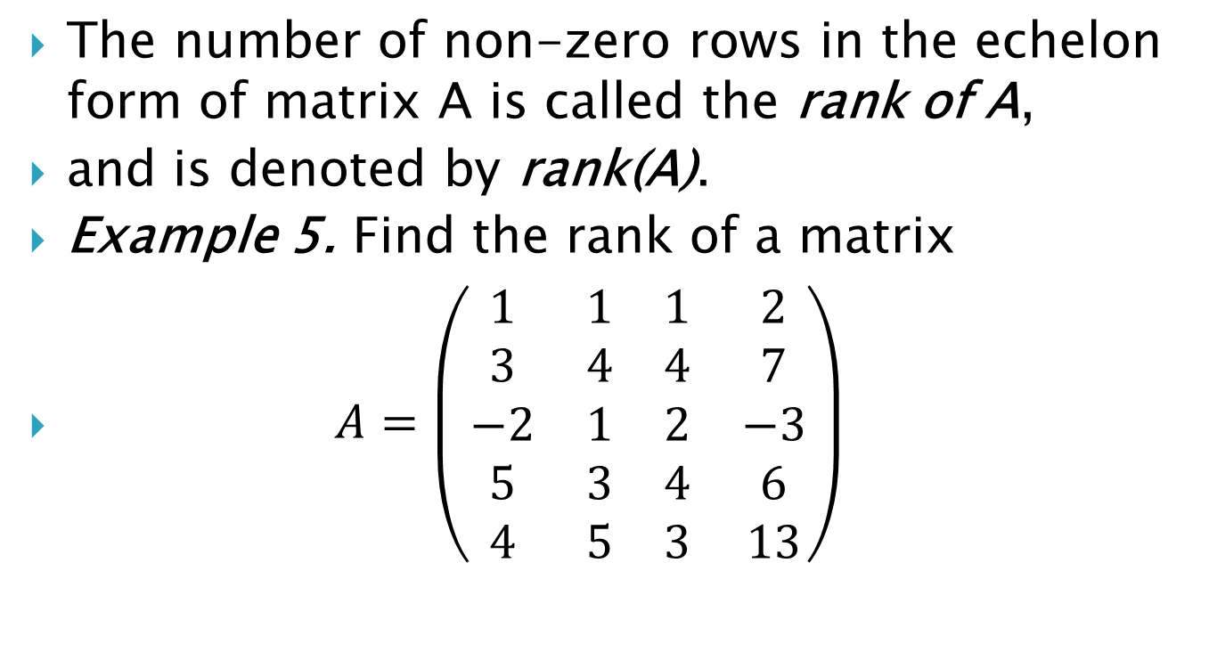
The number of non-zero rows in the echelon form of matrix A is called the rank of A,
and is denoted by rank(A).
Example 5. Find the rank of a matrix
$A=\left(\begin{matrix}1 & 1 & 1 & 2 \\ 3 & 4 & 4 & 7 \\ −2 & 1 & 2 & −3 \\ 5 & 3 & 4 & 6 \\ 4 & 5 & 3 & 13\end{matrix}\right)$

Slide 24

Example 6. Find the rank of a matrix
$B=\left(\begin{matrix}2 & −1 & 3 \\ 1 & 0 & 1 \\ 0 & 2 & −1 \\ 1 & 1 & 4\end{matrix}\right)$

Slide 25
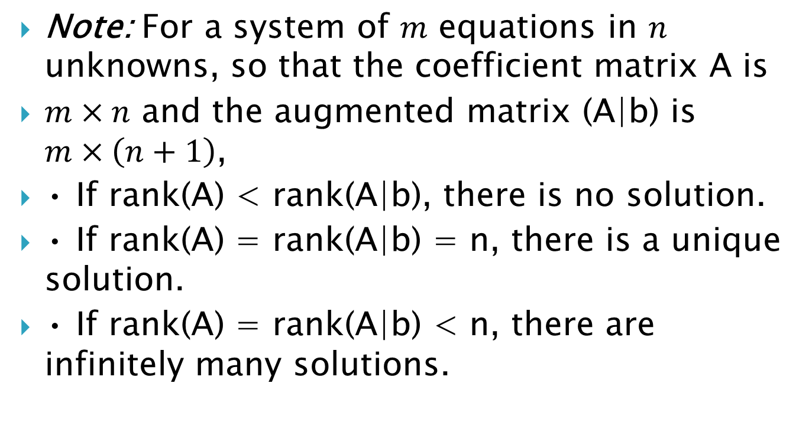
Note: For a system of $m$ equations in $n$ unknowns, so that the coefficient matrix A is
$m×n$ and the augmented matrix (A|b) is $m×\left(n+1\right)$,
• If rank(A) < rank(A|b), there is no solution.
• If rank(A) = rank(A|b) = n, there is a unique solution.
• If rank(A) = rank(A|b) < n, there are infinitely many solutions.

Slide 26
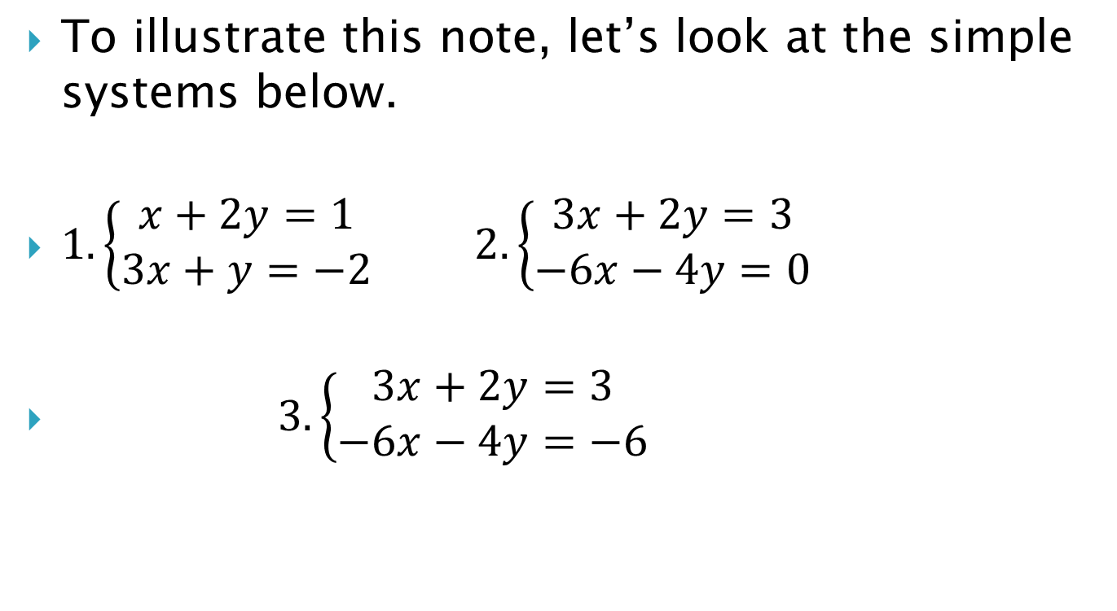
To illustrate this note, let’s look at the simple systems below.
$1.\left\{\begin{aligned}x+2y=1 \\ 3x+y=−2\end{aligned}\right.$ $2.\left\{\begin{aligned}3x+2y=3 \\ −6x−4y=0\end{aligned}\right.$
$3.\left\{\begin{aligned}3x+2y=3 \\ −6x−4y=−6\end{aligned}\right.$

Slide 27
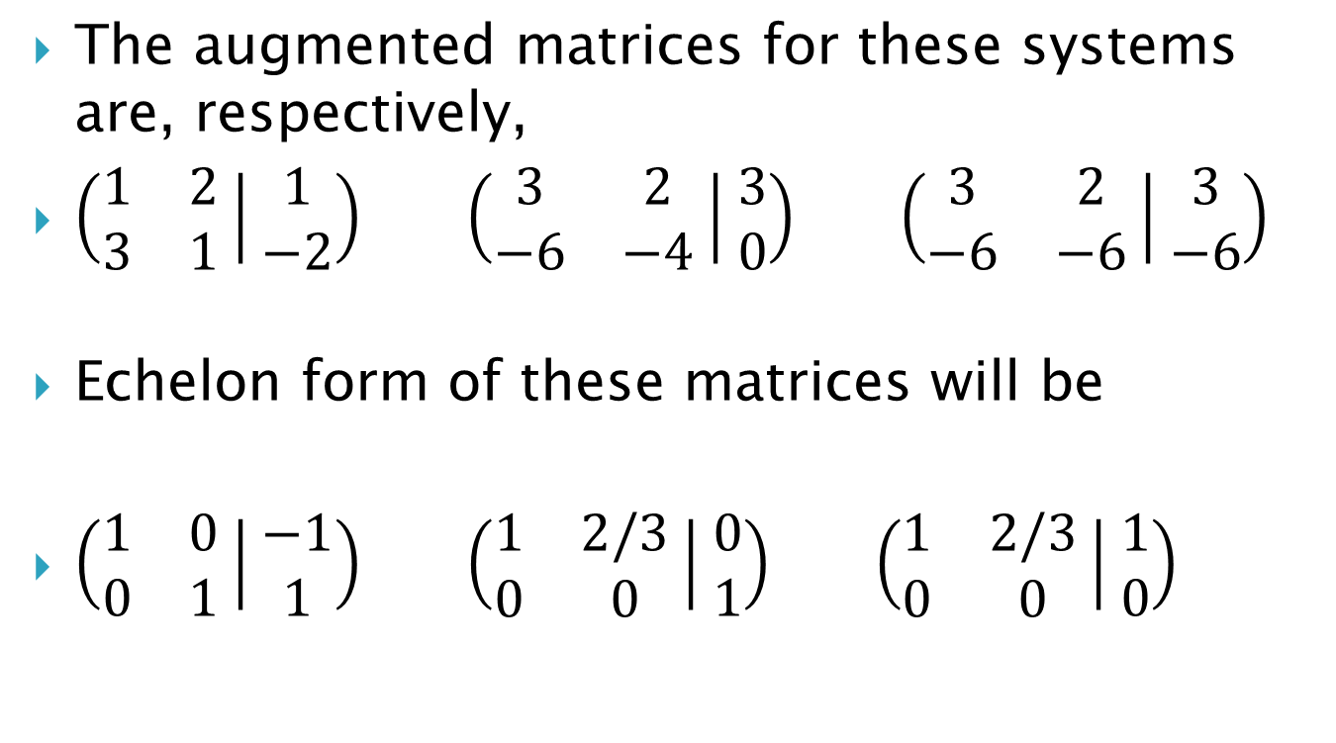
The augmented matrices for these systems are, respectively,
$\left(\begin{matrix}1 & 2 \\ 3 & 1\end{matrix} | \begin{matrix}1 \\ −2\end{matrix}\right)$ $\left(\begin{matrix}3 & 2 \\ −6 & −4\end{matrix} | \begin{matrix}3 \\ 0\end{matrix}\right)$ $\left(\begin{matrix}3 & 2 \\ −6 & −6\end{matrix} | \begin{matrix}3 \\ −6\end{matrix}\right)$
Echelon form of these matrices will be
$\left(\begin{matrix}1 & 0 \\ 0 & 1\end{matrix} | \begin{matrix}−1 \\ 1\end{matrix}\right)$ $\left(\begin{matrix}1 & 2/3 \\ 0 & 0\end{matrix} | \begin{matrix}0 \\ 1\end{matrix}\right)$ $\left(\begin{matrix}1 & 2/3 \\ 0 & 0\end{matrix} | \begin{matrix}1 \\ 0\end{matrix}\right)$

Slide 28

We summarize our findings in the table below:

Slide 29
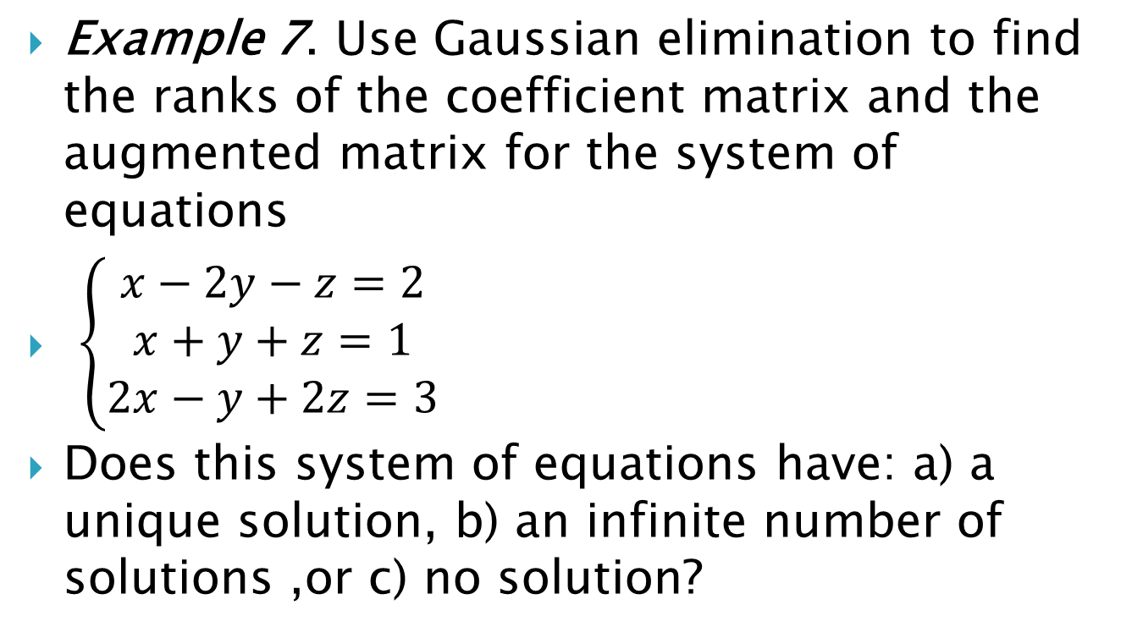
Example 7. Use Gaussian elimination to find the ranks of the coefficient matrix and the augmented matrix for the system of equations
$\left\{\begin{aligned}\begin{aligned}x−2y−z=2 \\ x+y+z=1\end{aligned} \\ 2x−y+2z=3\end{aligned}\right.$
Does this system of equations have: a) a unique solution, b) an infinite number of solutions ,or c) no solution?

Slide 30
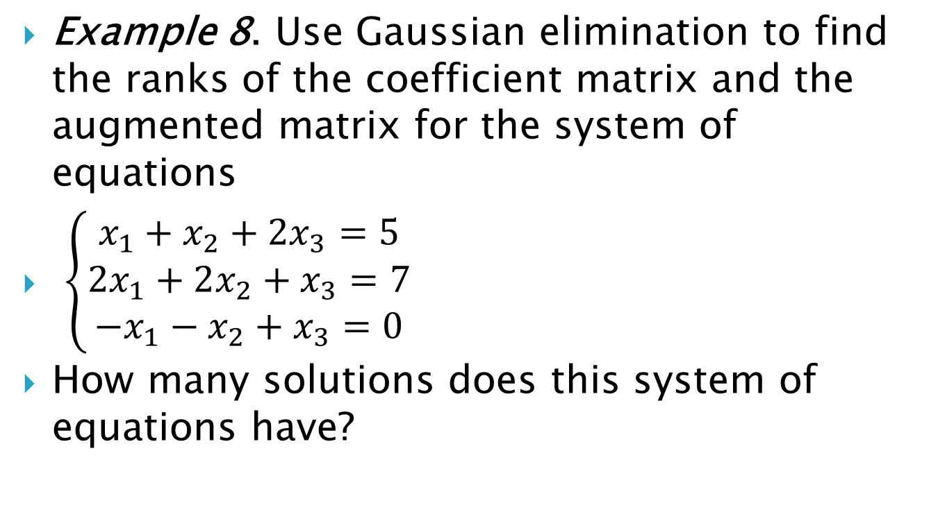
Example 8. Use Gaussian elimination to find the ranks of the coefficient matrix and the augmented matrix for the system of equations
$\left\{\begin{aligned}\begin{aligned}x_{1}+x_{2}+2x_{3}=5 \\ 2x_{1}+2x_{2}+x_{3}=7\end{aligned} \\ −x_{1}−x_{2}+x_{3}=0\end{aligned}\right.$
How many solutions does this system of equations have?

Slide 31
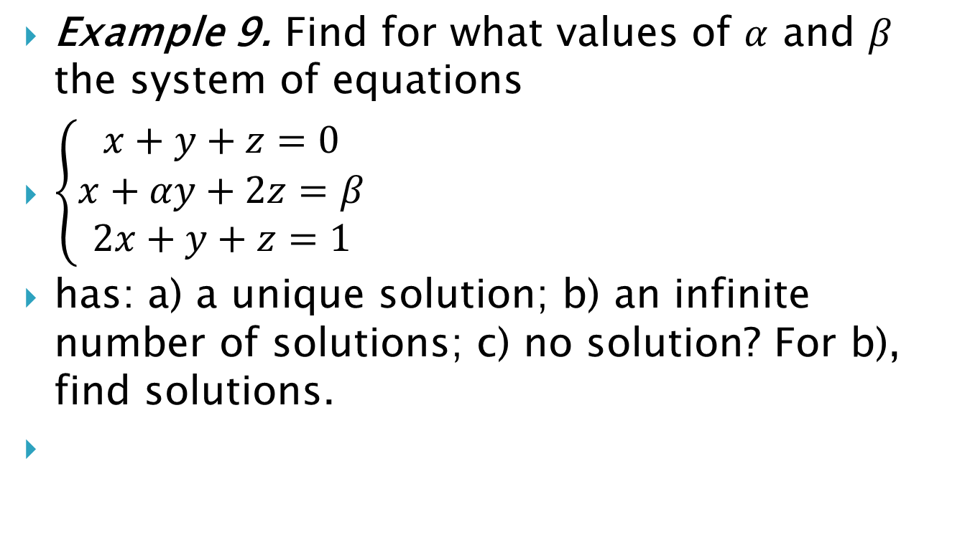
Example 9. Find for what values of $α$ and $β$ the system of equations
$\left\{\begin{aligned}\begin{aligned}x+y+z=0 \\ x+αy+2z=β\end{aligned} \\ 2x+y+z=1\end{aligned}\right.$
has: a) a unique solution; b) an infinite number of solutions; c) no solution? For b), find solutions.

Slide 32
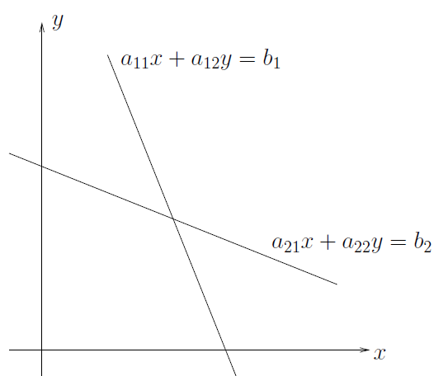

Geometric Interpretation
For two unknowns, the system of equations
$a_{11}x+a_{12}y=b_{1}$ and $a_{21}x+a_{22}y=b_{2}$ represents two lines in the plane. The lines are not parallel if $a_{11}a_{22}≠a_{21}a_{12}$.

Slide 33
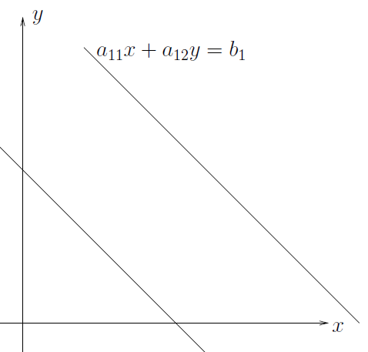
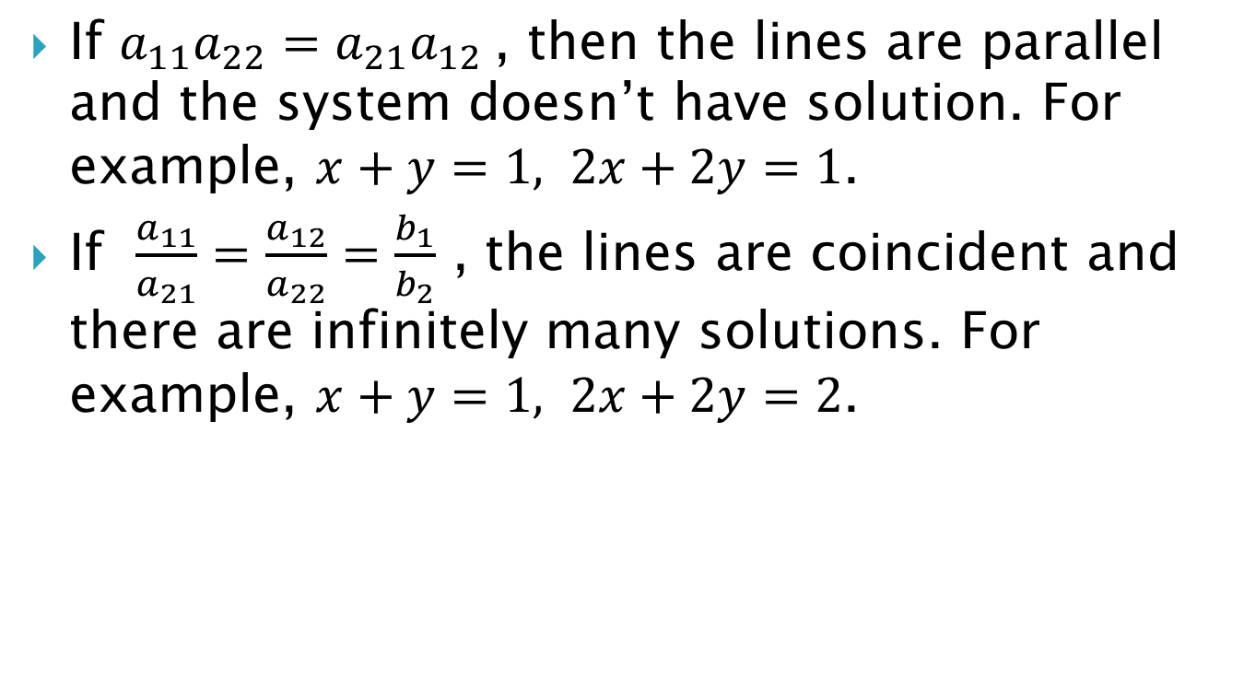
If $a_{11}a_{22}=a_{21}a_{12}$, then the lines are parallel and the system doesn’t have solution. For example, $x+y=1, 2x+2y=1$.
If $\frac{a_{11}}{a_{21}}=\frac{a_{12}}{a_{22}}=\frac{b_{1}}{b_{2}}$ , the lines are coincident and there are infinitely many solutions. For example, $x+y=1, 2x+2y=2$.

Slide 34
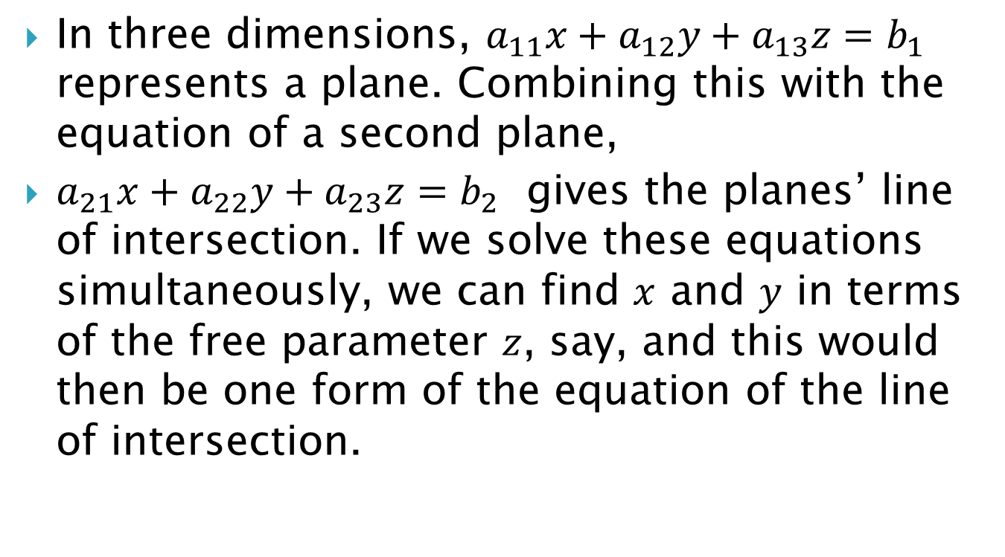
In three dimensions, $a_{11}x+a_{12}y+a_{13}z=b_{1}$ represents a plane. Combining this with the equation of a second plane,
$a_{21}x+a_{22}y+a_{23}z=b_{2}$ gives the planes’ line of intersection. If we solve these equations simultaneously, we can find $x$ and $y$ in terms of the free parameter $z$, say, and this would then be one form of the equation of the line of intersection.

Slide 35
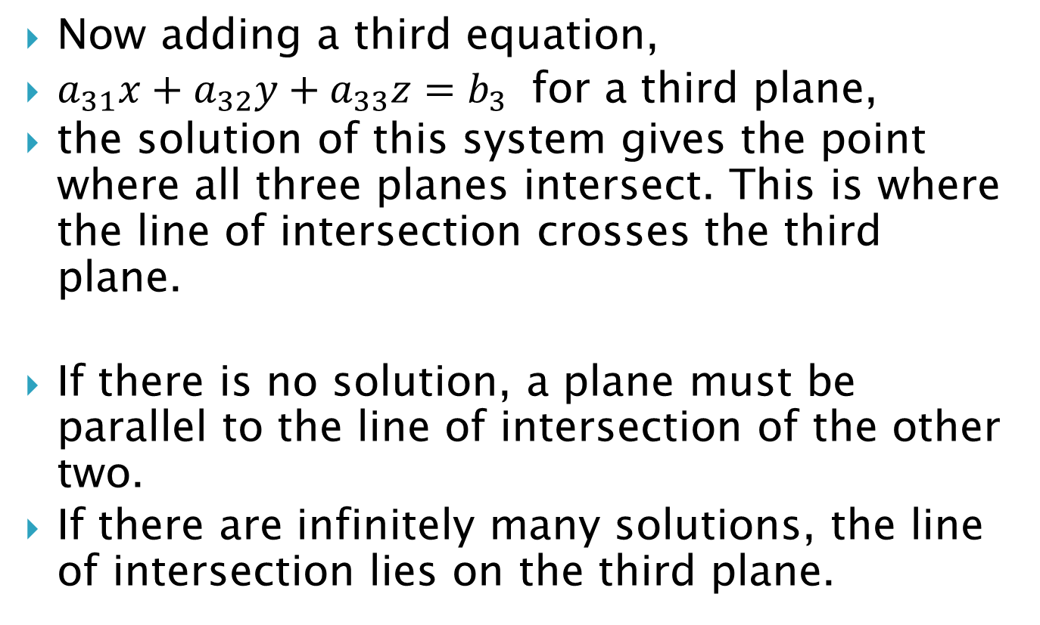
Now adding a third equation,
$a_{31}x+a_{32}y+a_{33}z=b_{3}$ for a third plane,
the solution of this system gives the point where all three planes intersect. This is where the line of intersection crosses the third plane.
If there is no solution, a plane must be parallel to the line of intersection of the other two.
If there are infinitely many solutions, the line of intersection lies on the third plane.

